Slide 1

TIME SERIES
Group members:
Michael WARNER
Suet Wah CHU
Jing Fei XU
Paris-Charles De Gaulle Airport

Slide 2
CONTENTS
ONE
TWO
THREE
FOUR
FIVE
Stationary
Box-Jenkins Methodology
Validation
Forecast
Description of Time Series

Slide 3

01.
Description of Tme Series
ONE

Slide 4
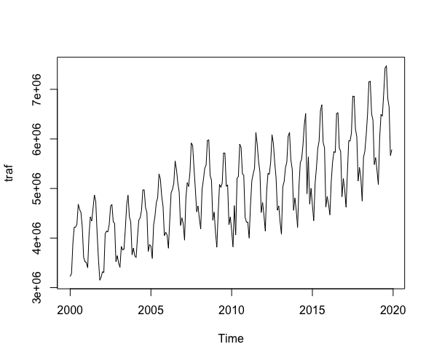
Description of time series
01
Time Series
Start time: Jan. 2000
End time: Dec. 2019
Frequency: 12
No missing data

Slide 5
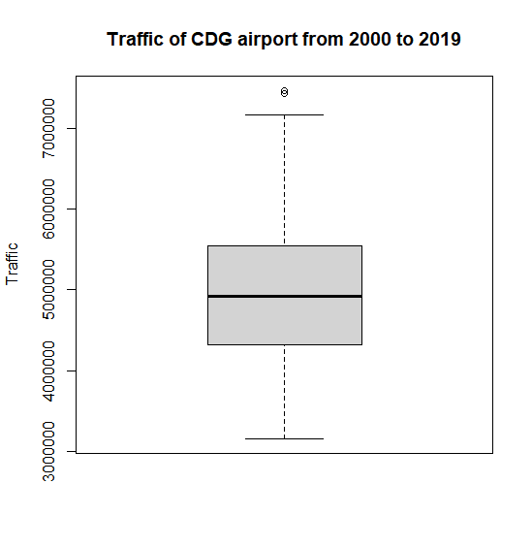
Description of time series
01
Max. : 7474058
Upper quartile : 5538816
Mean : 4956670
Median : 4920756
Lower Quartile : 4319892
Min. : 3149993

Slide 6
02.
Stationary
TWO

Slide 7
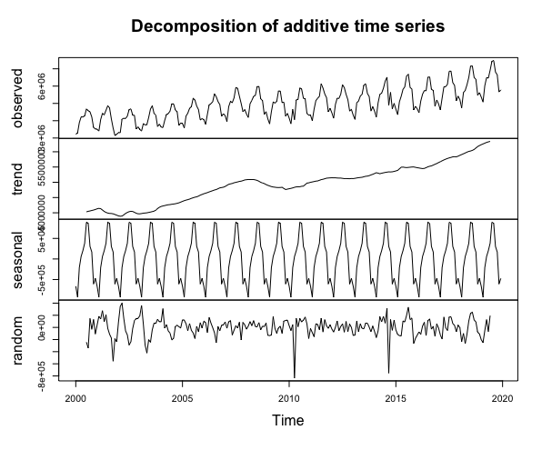
02
Stationary
Observed: non stationary and non-constant variance (variance increases over time)
Reason 1 : Upward Trend
Reason 2 : Sesonality
a regularly repeating pattern of highs and lows related to years
Random : Some outliers are far away from other data
Traffic at CDG Airport per month ( 2000 ~ 2019)

Slide 8
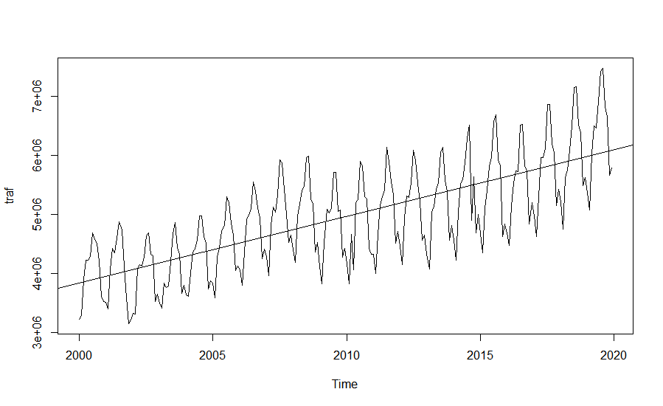
02
Stationary
Non Stationary:
Trend
The linear regression line is upward sloping, i.e. there is an incresing trend
Traffic at CDG Airport per month ( 2000 ~ 2019)

Slide 9
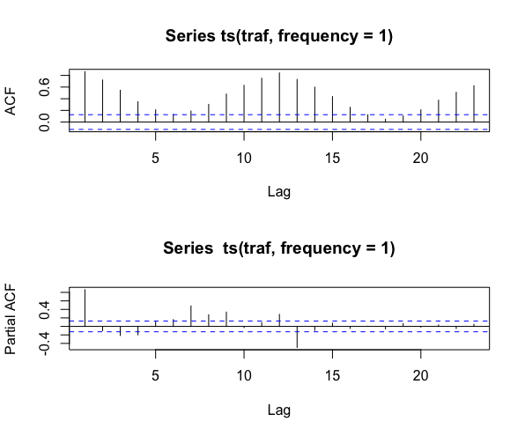
02
Stationary
Non Stationary:
Seasonality
with ACF & PACF Method
ACF and PACF do not decay fast to zero
We can see the seasonality effect from the ACF and PACF
Traffic at CDG Airport per month ( 2000 ~ 2019)

Slide 10
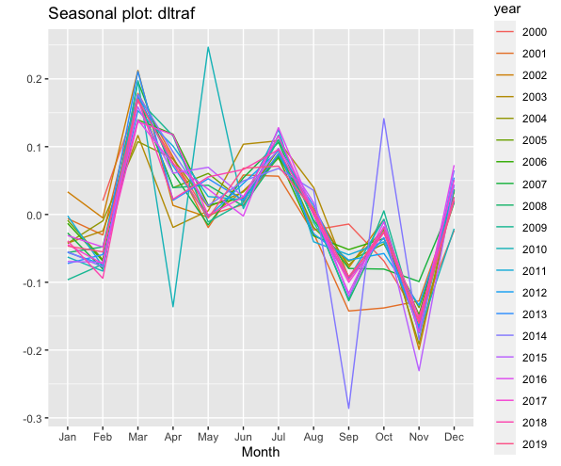
02
Stationary
Non Stationary:
Seasonality
with Integrated Line Graph Method
The data has a drop from July to September and some clear seasonal patterns in December where the data is growing from November to December
Traffic at CDG Airport per month ( 2000 ~ 2019)

Slide 11
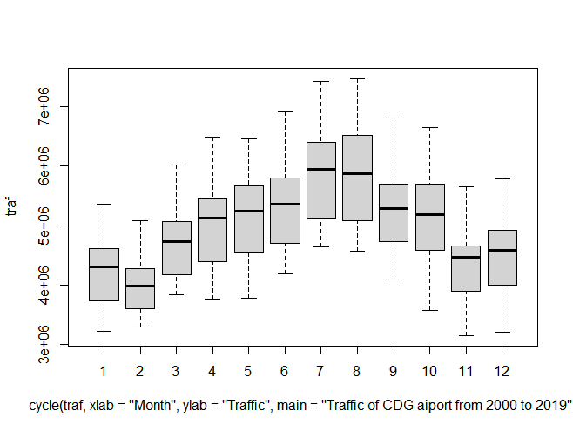
02
Stationary
Non Stationary:
Seasonality
with Boxplot Method
The traffic rebounces from March to August after a continuous drop from September to February
Traffic at CDG Airport per month ( 2000 ~ 2019)

Slide 12
02.1
Moving to Stationary
TWO.ONE

Slide 13
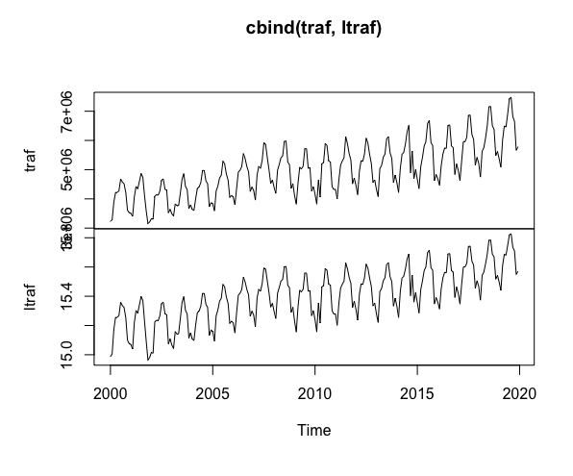
02
Moving to Stationary
Reducing Variance by Log Transformation
Before:
After :
ACF and PACF still show the seasonality of the time series
Before : The variance increases over time
After : The variance becomes more constant

Slide 14
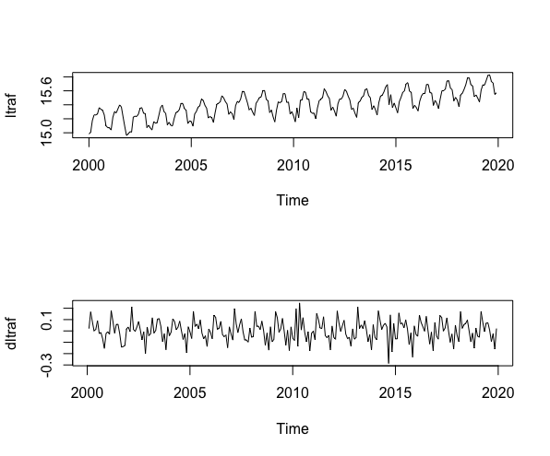
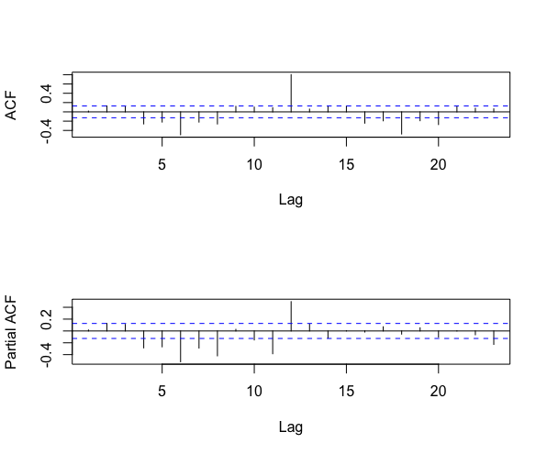
02
Moving to Stationary
Removing Trend by First Difference (d =1)
ACF and PACF do not decay fast to zero
We can see the seasonality effect from the ACF and PACF
Before:
After :
Before: a upward trend
After : mean is constant , i.e. no trend

Slide 15
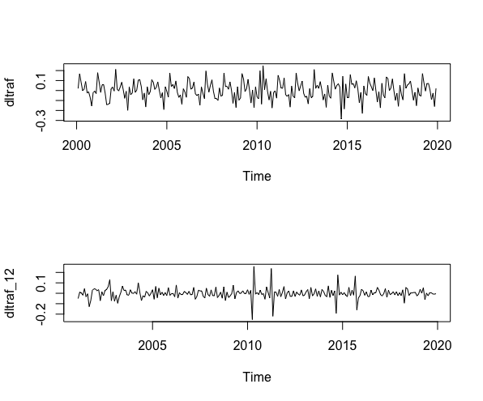
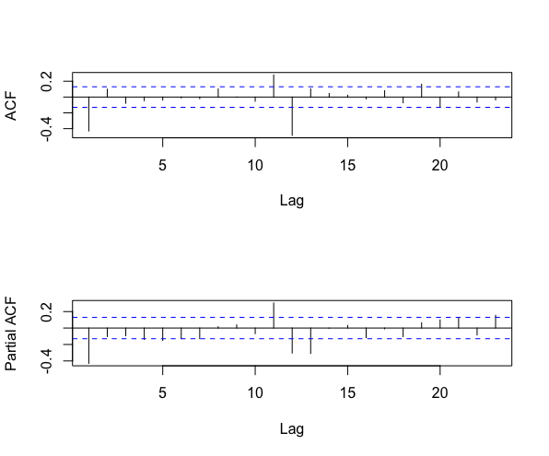
02
Moving to Stationary
Removing Seasonality by Taking Difference of Lag 12 (D =1)
ACF & PACF:
the coefficients are mostly non significant, except at lag1, lag11, lag12 and lag13
the seasonality effect has been removed
Before:
After :
To remove seasonality
There’re some extreme values on the graph

Slide 16
03.
Box-Jenkins Methodology
THREE

Slide 17
03
Box-Jenkins Methodology
1
2
3
Identification
Estimation
&
Selection
Checking

Slide 18
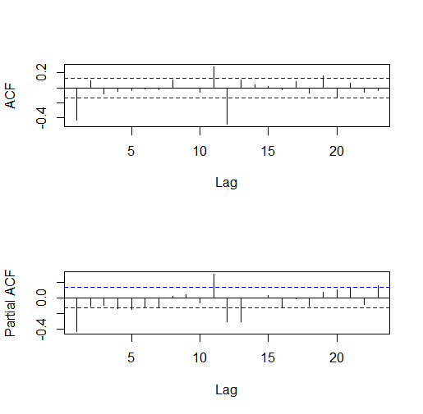
03
Box-Jenkins Methodology - Identification
First Trial :
ACF:
Lag 1, Lag11 and Lag 12 are significantly away from 0
→ q =1 , Q = 1 (m = 12)
PACF:
Lag 1, Lag11, Lag 12 and Lag 13 are significantly differenct from 0
→ p =1 ,P = 1 (m = 12)
We have taken differentiation at Lag 1 and Lag 12
→ d = 1 , D = 1 (m =12)
First Trial → ARIMA (1,1,1)(1,1,1)[12]

Slide 19
03
Box-Jenkins Methodology - Identification
Second Trial :
ACF:
Lag 1, Lag11 and Lag 12 are significantly away from 0
→ q =1 , Q = 1 (m = 12)
PACF:
Lag 1, Lag11, Lag 12 and Lag 13 are significantly differenct from 0
→ p =1 ,P = 0 (m = 12)
We have taken differentiation at Lag 1 and Lag 12
→ d = 1 , D = 1 (m =12)
Second Trial → ARIMA (1,1,1)(0,1,1)[12]

Slide 20
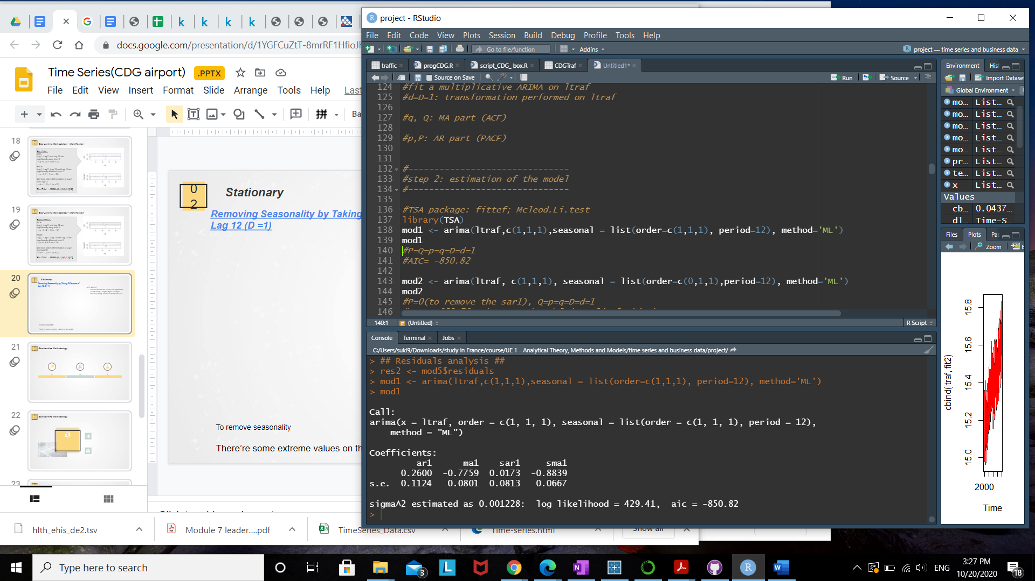
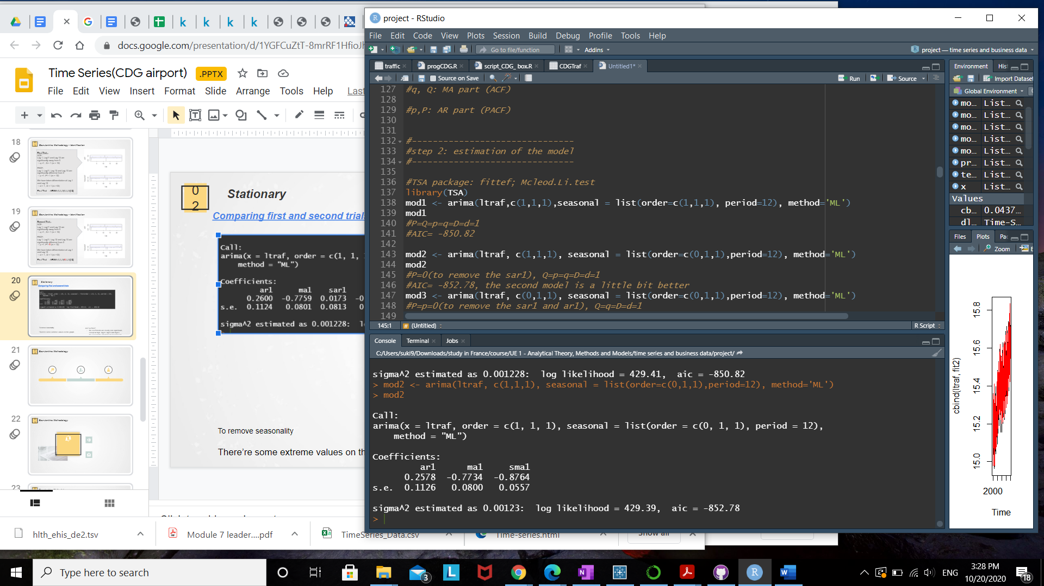
02
Box-Jenkins Methodology - Estimation & Selection
Comparing first and second trials
First Trial : ARIMA (1,1,1)(1,1,1)[12]
Second Model is better since the AIC is lower
Second Trial : ARIMA (1,1,1)(0,1,1)[12]

Slide 21
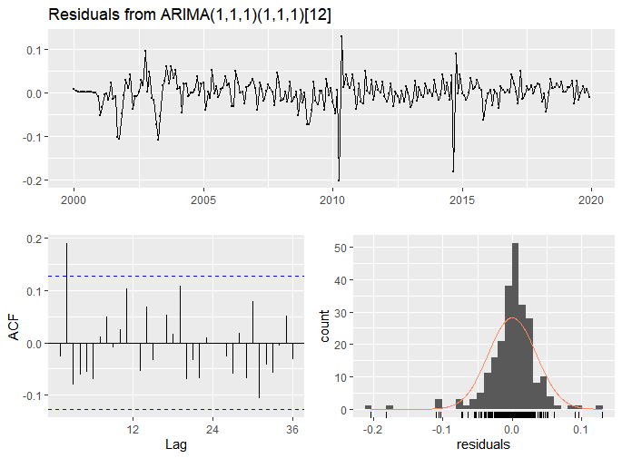
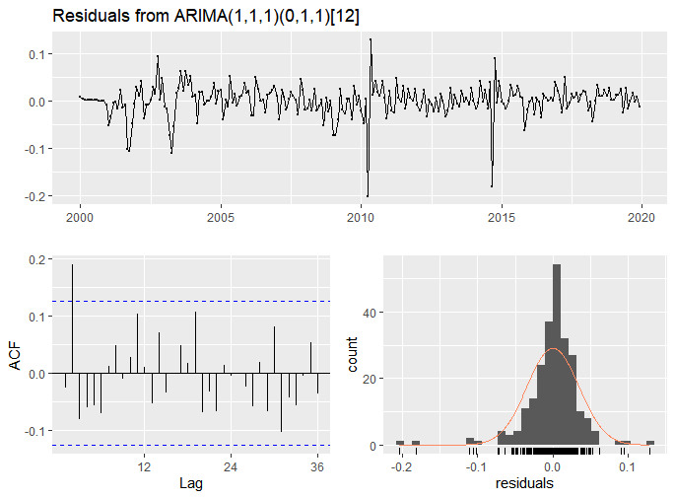
02
Box-Jenkins Methodology - Checking
Comparing first and second trials with Residual diagnostics
First Trial : ARIMA (1,1,1)(1,1,1)[12]
Second Trial : ARIMA (1,1,1)(0,1,1)[12]
Two models have similar result except different distribution of the residuals
-> Second model has a more concentrated distribution of residuals
We will keep the Second Model since the AIC is lower

Slide 22
03
Box-Jenkins Methodology - Identification
Third Trial :
ACF:
Lag 1, Lag11 and Lag 12 are significantly away from 0
→ q =1 , Q = 1 (m = 12)
PACF:
Lag 1, Lag11, Lag 12 and Lag 13 are significantly differenct from 0
→ p = 0 ,P = 0 (m = 12)
We have taken differentiation at Lag 1 and Lag 12
→ d = 1 , D = 1 (m =12)
Third Trial → ARIMA (0,1,1)(0,1,1)[12]
We will compare the second model with the third one to see which one is better

Slide 23
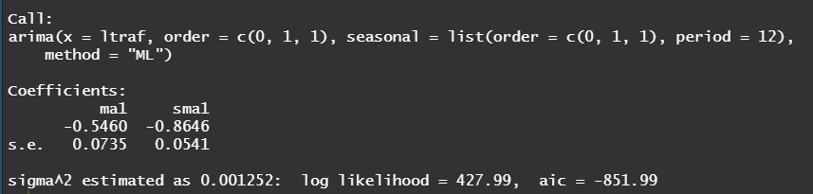
02
Box-Jenkins Methodology - Estimation & Selection
Comparing Second and Third trials
Second Trial : ARIMA (1,1,1)(0,1,1)[12]
Second Model is better since the AIC is lower
Third Trial : ARIMA (0,1,1)(0,1,1)[12]

Slide 24
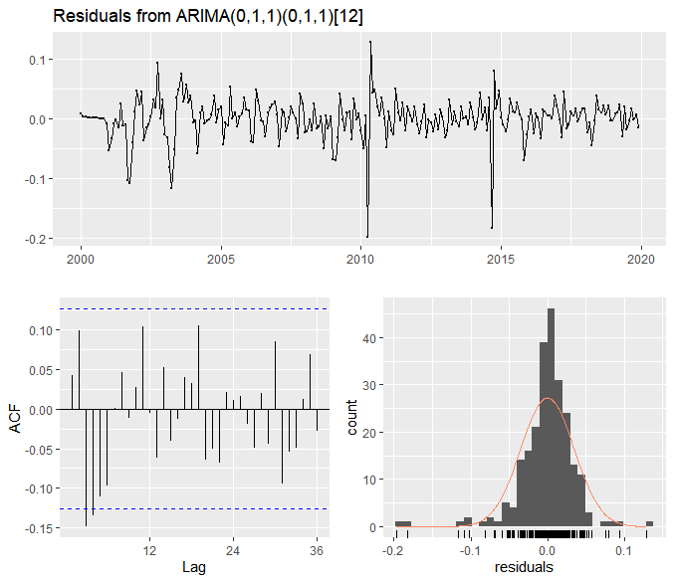
02
Box-Jenkins Methodology - Checking
Comparing Second and Third trials with Residual diagnostics
Second Trial : ARIMA (1,1,1)(0,1,1)[12]
Third Trial : ARIMA (0,1,1)(0,1,1)[12]
1. ACF: second model has a significant difference at lag 2; third model has a significant difference at lag 3
2. Third model has a more concentrated distribution of residuals
We will keep the Second Model since the AIC is lower

Slide 25
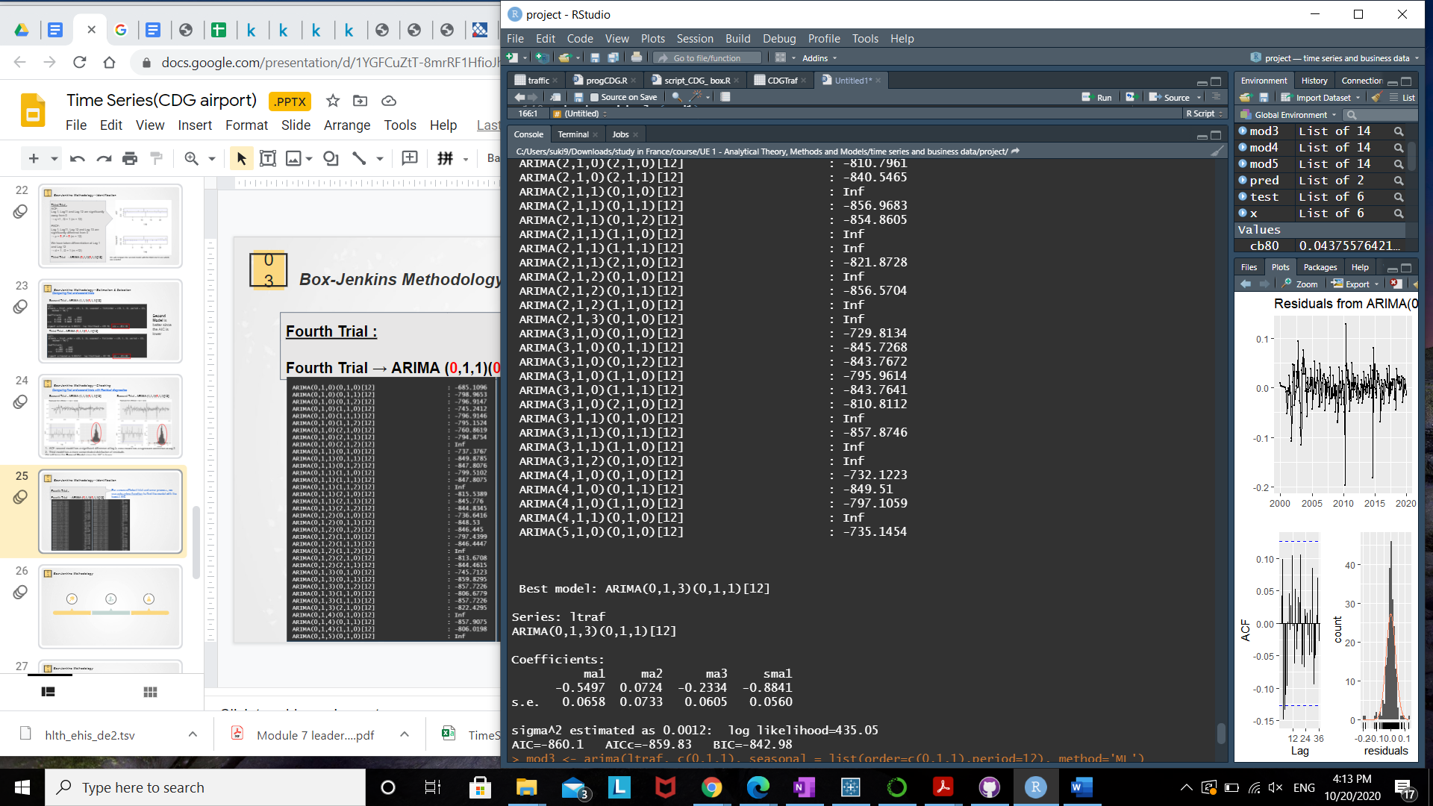
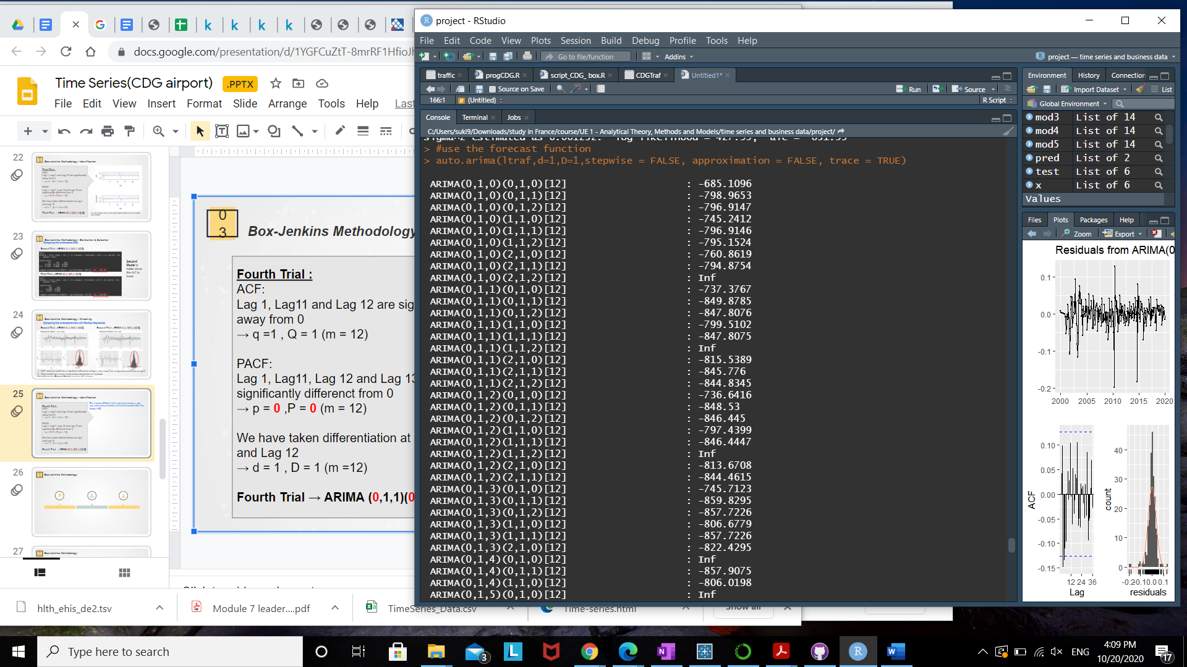
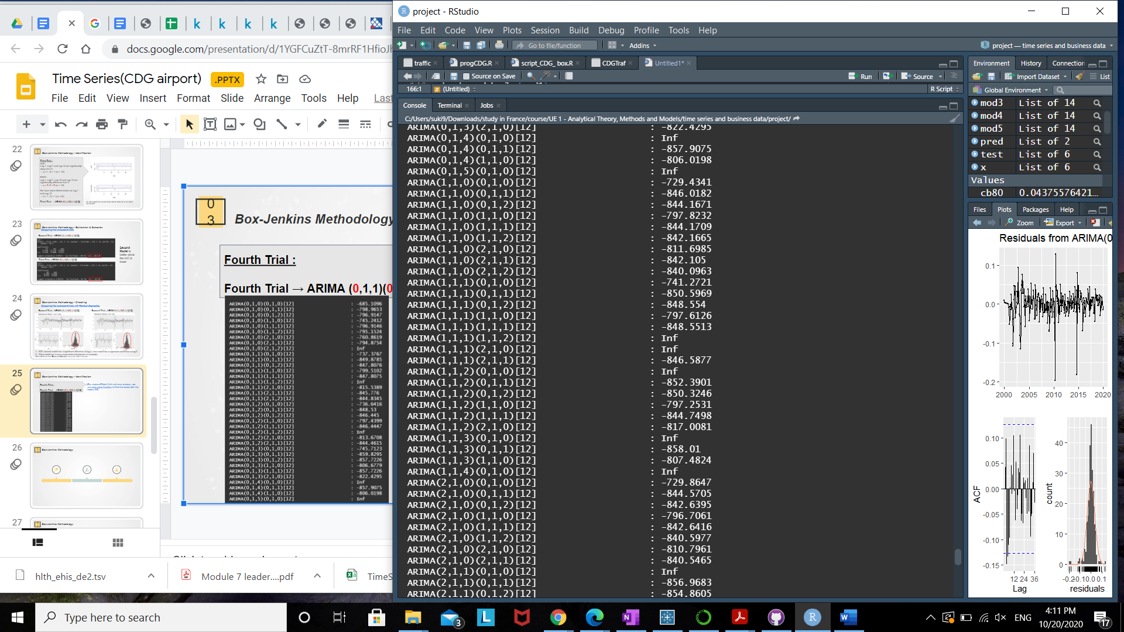
03
Box-Jenkins Methodology - Identification
Fourth Trial :
Fourth Trial → ARIMA (0,1,1)(0,1,1)[12]
For a more efficient trial-and-error process, we use auto.arima function to find the model with the lowest AIC

Slide 26
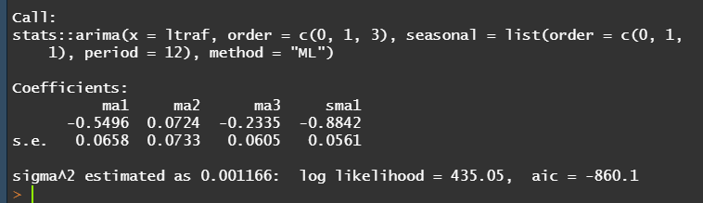
02
Box-Jenkins Methodology - Estimation & Selection
Comparing Second and Fourth models
Second Trial : ARIMA (1,1,1)(0,1,1)[12]
Fourth Trial : ARIMA (0,1,3)(0,1,1)[12]
Fourth Model is better since the AIC is lower

Slide 27
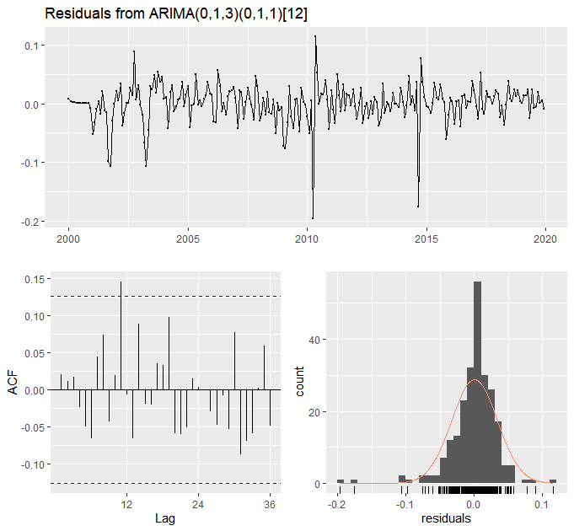
02
Box-Jenkins Methodology - Checking
Comparing Second and Fourth trials with Residual diagnostics
Second Trial : ARIMA (1,1,1)(0,1,1)[12]
Fourth Trial : ARIMA (0,1,3)(0,1,1)[12]
1. ACF: second model has a significant difference at lag 2; fourth model has a significant difference at lag 11
2. Fourth model has a more concentrated distribution of residuals
We will keep the Fourth Model since the AIC is lower

Slide 28
04.
Validation
FOUR

Slide 29
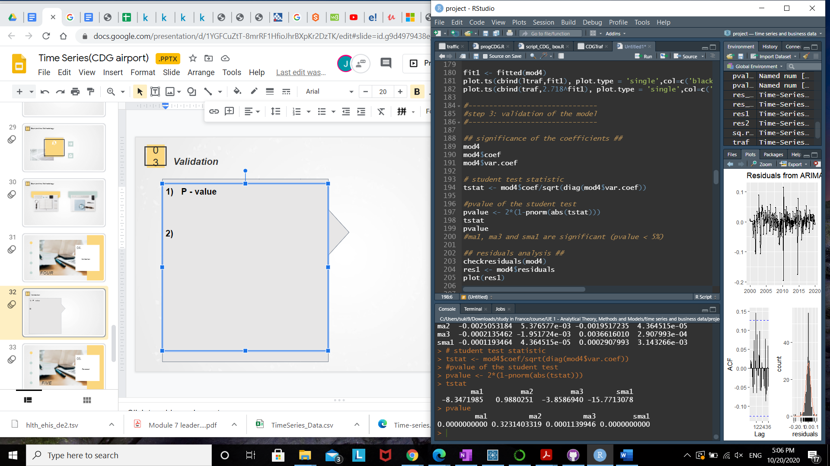
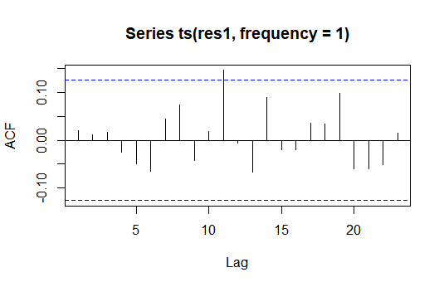
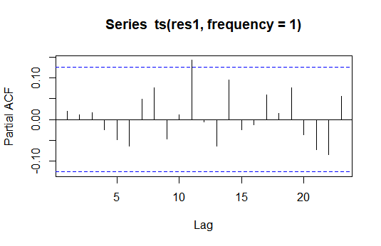
03
Validation
P - value of student t-test
ma1, ma3 and sma1 are significant (p-value < 5%)
ACF of residuals
Mostly insignificant except at lags 11 which is slightly significant
→ the residuals are not significantly autocorrelated
PACF of residuals
Mostly insignificant except lags 11 which is slightly significant

Slide 30
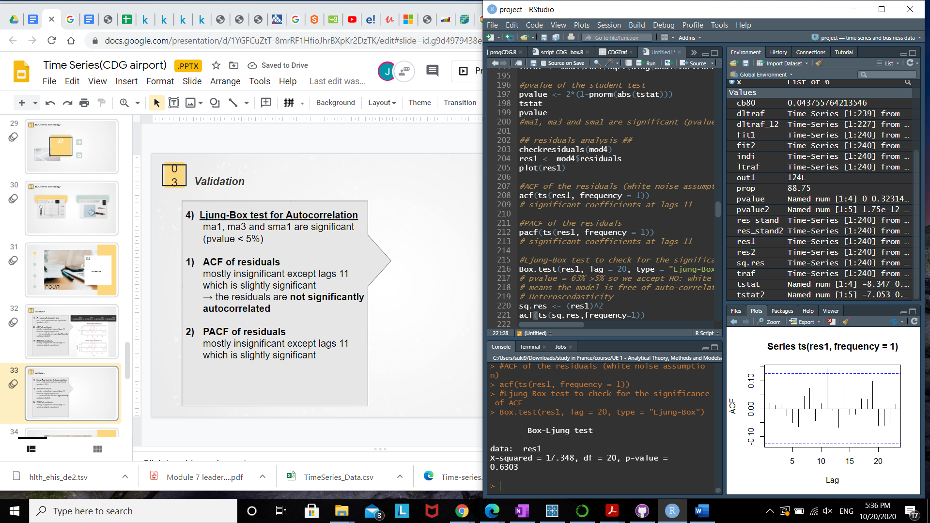
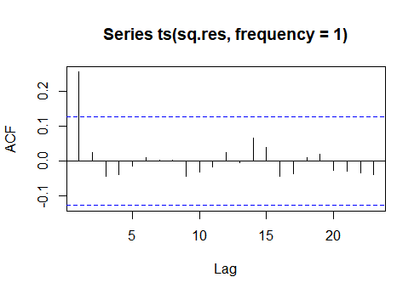
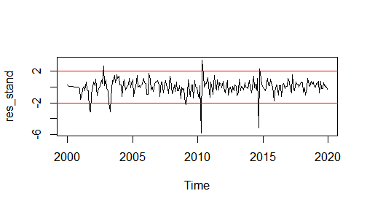
03
Validation
4) Ljung-Box test for Autocorrelation of residuals
p-value = 0.6303 < 5%
we accept H0: white noise assumption
5) Heteroskedasticity of residuals
The first correlation is significant so there seems to be a non constant variance
It may be due to the outliers we have identified on the graph of the residuals
6) Normality assumption of residuals
The standardized results should lie in between -2 and 2 (with 95% of chance)
→ Almost fit within the lines except few outliers
→ Normality assumption is not satisfied
We can conclude that the residuals are white noise and the model is Valid

Slide 31
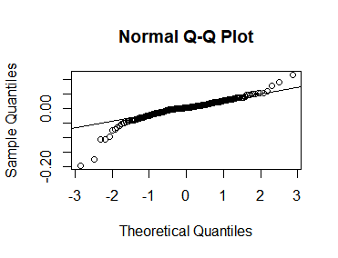
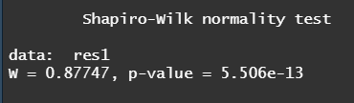
03
Validation
6) Normality assumption of residuals
(b) QQ-plot :
the points fall along a line in the middle of the graph, but curve off in the extremities
the residuals have more extreme values than would be expected for a Normal distribution
→ the residuals are not normally distributed
(c ) Shapiro test:
p-value = 5.506e-13 < 5%
we reject H0: normality assumption
(d) Jarque.bera test :
p-value = 2.2e-16 < 5%
we reject H0: normality assumption
We can conclude that the residuals are white noise and the model is Valid

Slide 32
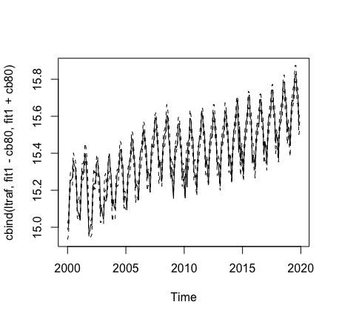
05
Validation
Proportion of points in the confidence bound = 88.75% > 80%
The fit is considered good
Quality of the fit

Slide 33
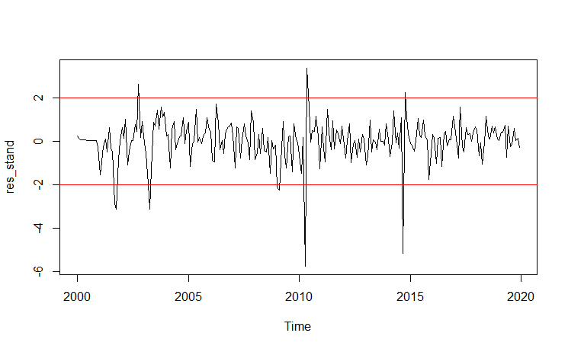
05
Validation - Dummy Variables - Use and rejection
Dummy variables were created to replace the largest outliers in the residual data to try to improve the model.
Data points that were selected to be removed to try to improve the model.

Slide 34
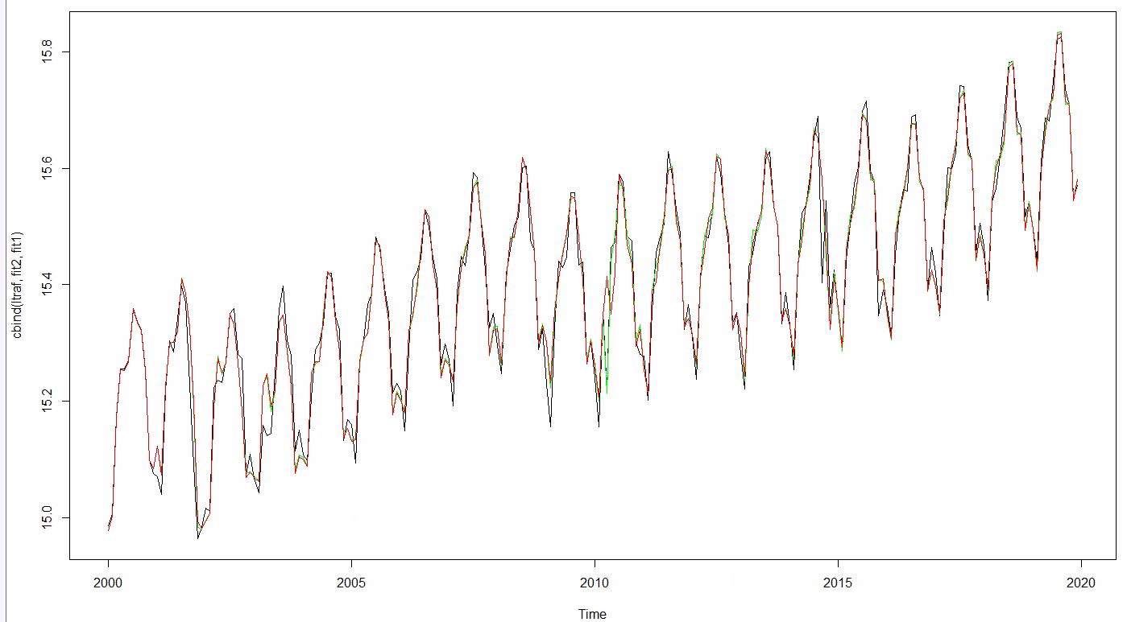
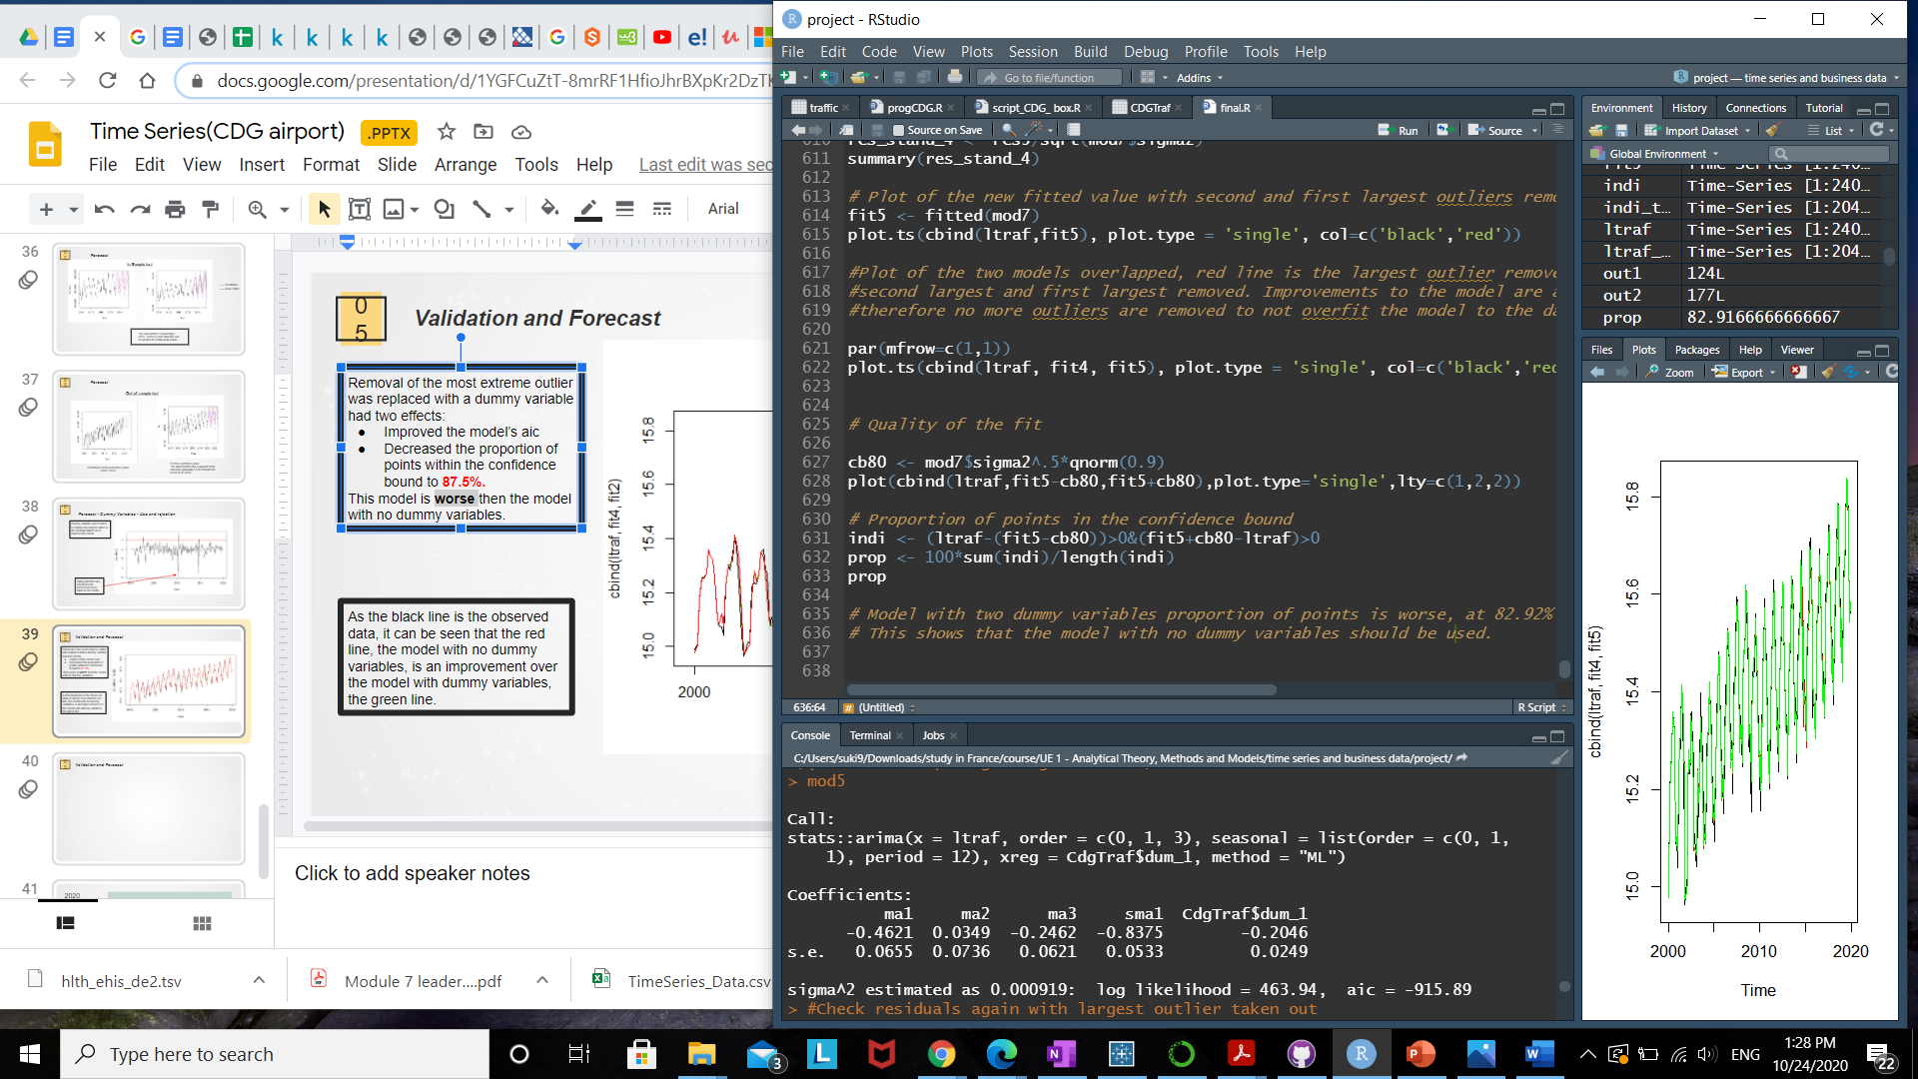
05
Validation - Dummy Variables - Use and rejection
Removal of the most extreme outlier was replaced with a dummy variable had two effects:
Improved the model’s aic
Decreased the proportion of points within the confidence bound to 87.5%.
This model is worse than the model with no dummy variables.
As the black line is the observed data, it can be seen that the red line, the model with no dummy variables, is an improvement over the model with dummy variables, the green line.

Slide 35
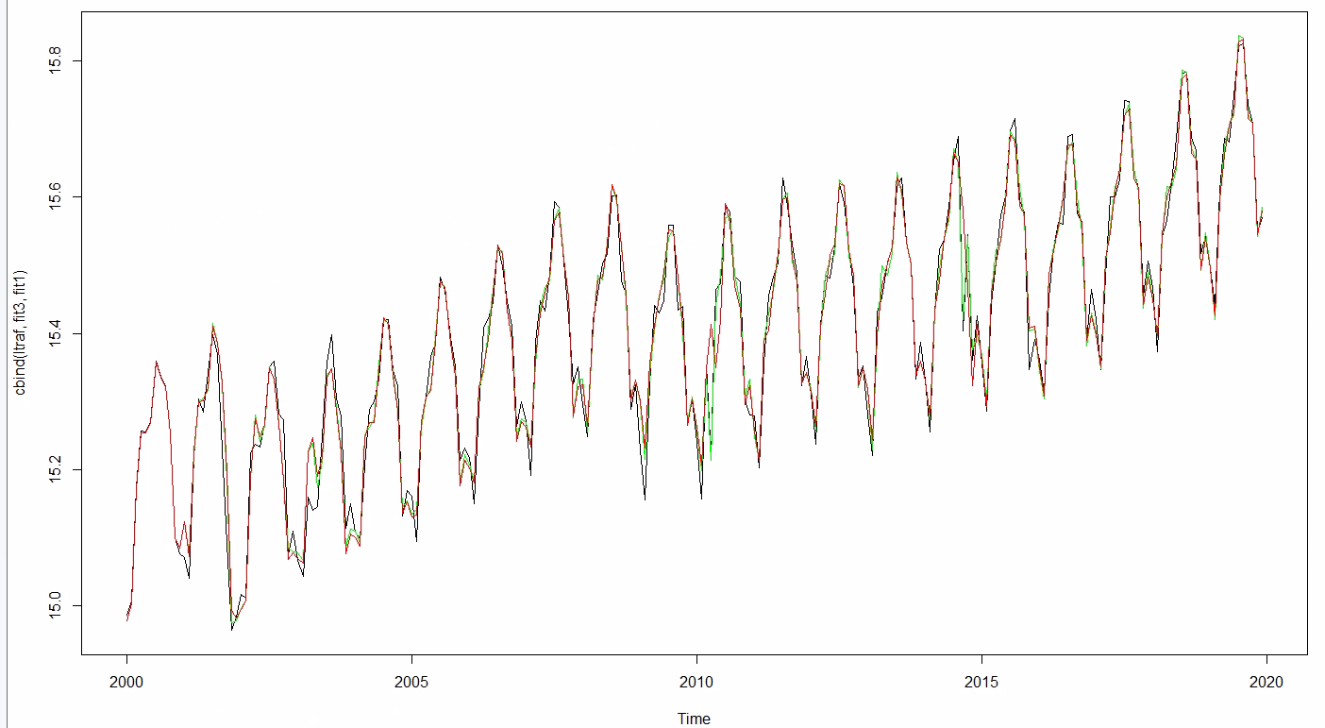
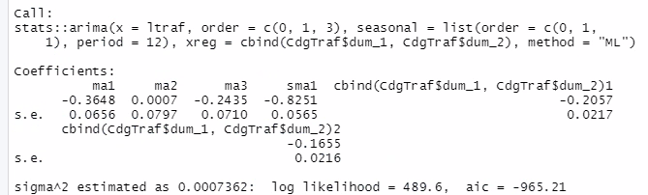
05
Validation - Dummy Variables - Use and rejection
Removal of the two most extreme outliers was tested and replaced with a dummy variable had two effects:
Improved the model’s aic
Decreased the proportion of points within the confidence bound to 82.92%.
This model is even worse than the model with one dummy variables.
As with the previous model of one dummy variable, it can be seen that the new model with two dummy variables, the green line, is even worse off as there are now two major sections not fitting the model correctly.

Slide 36
05.
Forecast
FIVE

Slide 37
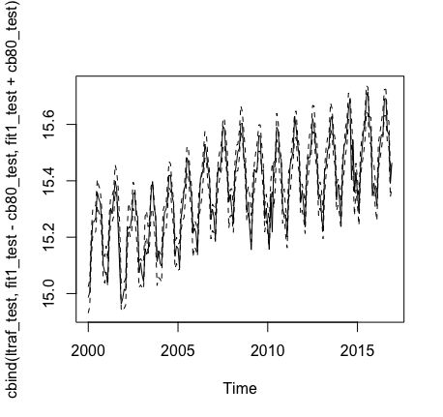
05
Forecast
In-Sample test
Quality of fit
Creating a model to predict the traffic data from 2017 to 2019, and comparing them with the real data
Proportion of points in the confidence bound = 88.24%

Slide 38
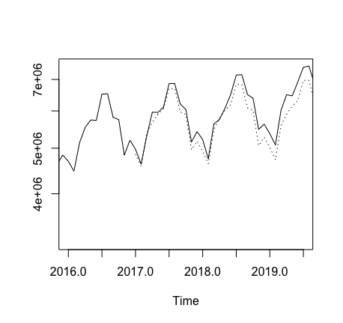
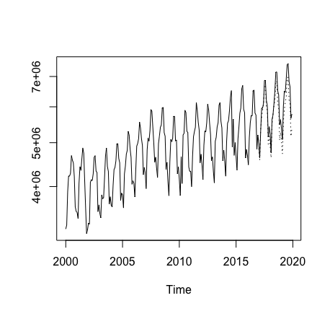
05
Forecast
In-Sample test
In the year 2017, the predicted data is almost identical to the actual airport traffic data, but there are some gaps in 2019
Comparison between the predictive model and the real data(2016~2019)

Slide 39
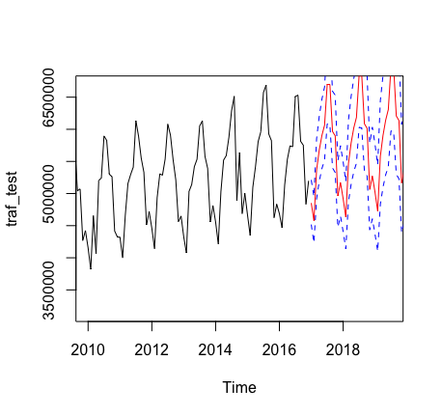
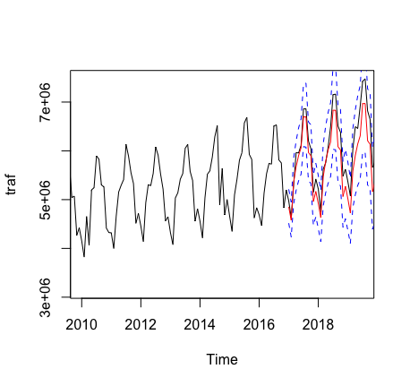
05
Forecast
In-Sample test
—— Prediction
—— Real Traffic
The real number of passenger (2017~2019) is more than the one we predict at certain peak points

Slide 40
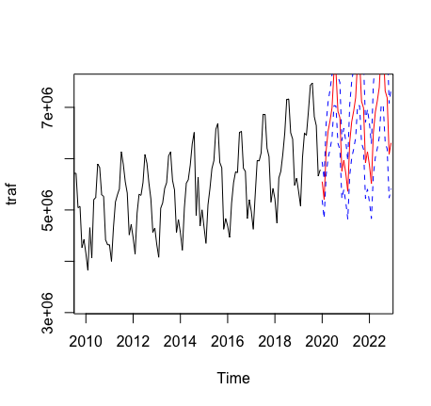
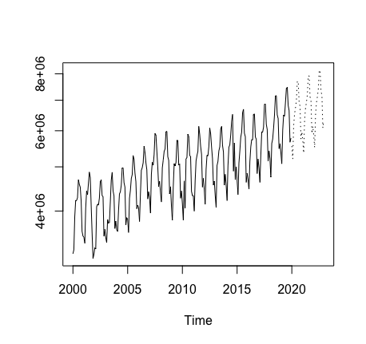
05
Forecast
Out-of-sample test
For the next three years:
The airport traffic has a upward trend (increase gradually if not consider the covid-19 in 2020)
Prediction for the next three years
(2020~2023)

Slide 41
05
Conclusion
The selected model : ARIMA (0,1,3)(0,1,1)[12] with no dummy variables
AIC : -860.1
Residuals : White Noise
Proportion of points in the confidence bound = 88.24%
The model fits the sample quite well and over 80% of the sample can be predicted within the confidence bound

Slide 42
2020
THANK YOU.
,

